Slide 1



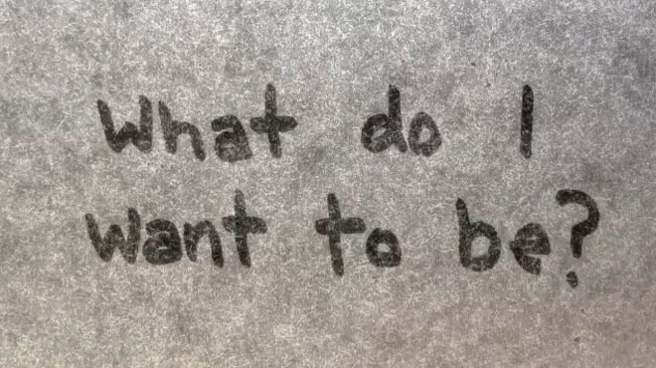
Dale Stubbs - 14024149
An interesting fact I have learned from the course is
that Incognito Mode on your browser doesn’t hide what you’re looking at!
My project is a new Password Manager Browser Plug-in that uses a sentence to generate new passwords
I intend to evaluate the job market systematically and attempt to gain the job that is most beneficial to me.
(Layman's terms – I still don’t know what I want to be when I grow up!)
DDoS of DYN managed to shut down almost half of the internet for a substantial amount of time back in October

